Slide 1
Multimedia Database

Slide 2
What is a Multimedia DBMS?
A multimedia database management system (MM-DBMS) is a framework that manages different types of data potentially represented in a wide diversity of formats on a wide array of media sources.
Like the traditional DBMS, MM-DBMS should address requirements:
  Integration
    Data items do not need to be duplicated for different programs
  Data independence
    Separate the database and the management from the application programs
  Concurrency control
    allows concurrent transactions
MM Database

Slide 3
Requirements of Multimedia DBMS
  Persistence
    Data objects can be saved and re-used by different transactions and program invocations
  Privacy
    Access and authorization control
  Integrity control
    Ensures database consistency between transactions
  Recovery
    Failures of transactions should not affect the persistent data storage
  Query support
    Allows easy querying of multimedia data
MM Database

Slide 4
Requirements of Multimedia DBMS (cont.)
In addition, an MM-DBMS should:
  have the ability to uniformly query data (media data, textual data) represented in different formats.
  have the ability to simultaneously query different media sources and conduct classical database operations across them.
  ⇒ query support
  have the ability to retrieve media objects from a local storage device in a smooth jitter-free (i.e. continuous) manner.
  ⇒ storage support
  have the ability to take the answer generated by a query and develop a presentation of that answer in terms of audio-visual media.
  have the ability to deliver this presentation in a way that satisfies various Quality of Service requirements.
  ⇒ presentation and delivery support
MM Database

Slide 5
A Sample Multimedia Scenario
Consider a police investigation of a large-scale drug operation. This investigation may generate the following types of data
  Video data captured by surveillance cameras that record the activities taking place at various locations.
  Audio data captured by legally authorized telephone wiretaps.
  Image data consisting of still photographs taken by investigators.
  Document data seized by the police when raiding one or more places.
  Structured relational data containing background information, back records, etc., of the suspects involved.
  Geographic information system data remaining geographic data relevant to the drug investigation being conducted.
MM Database

Slide 6
Possible Queries
Image Query (by example):
Police officer Rocky has a photograph in front of him.
He wants to find the identity of the person in the picture.
Query: “Retrieve all images from the image library in which the person appearing in the (currently displayed) photograph appears”
Image Query (by keywords):
Police officer Rocky wants to examine pictures of “Big Spender”.
Query: "Retrieve all images from the image library in which “Big Spender” appears."
MM Database

Slide 7
Possible Queries (cont.)
Video Query:
Police officer Rocky is examining a surveillance video of a particular person being fatally assaulted by an assailant. However, the assailant's face is occluded and image processing algorithms return very poor matches. Rocky thinks the assault was by someone known to the victim.
Query: “Find all video segments in which the victim of the assault appears.”
By examining the answer of the above query, Rocky hopes to find other people who have previously interacted with the victim.
Heterogeneous Multimedia Query:
Find all individuals who have been photographed with “Big Spender” and who have been convicted of attempted murder in South China and who have recently had electronic fund transfers made into their bank accounts from ABC Corp.
MM Database

Slide 8
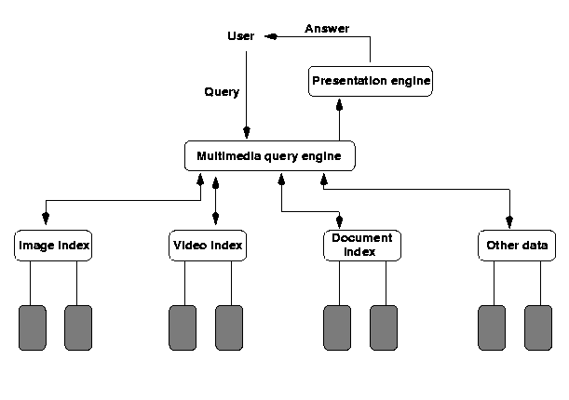
MM Database Architectures
Based on Principle of Autonomy
Each media type is organized in a media-specific manner suitable for that media type
Need to compute joins across
different data structures
Relatively fast query
processing due to
specialized structures
MM Database

Slide 9
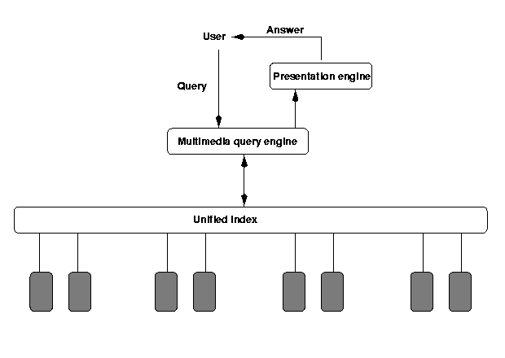
MM Database Architectures (cont.)
Based on Principle of Uniformity
A single abstract structure to index all media types
Abstract out the common part of different media types (difficult!) - metadata
One structure - easy implementation
Annotations for different
media types
MM Database

Slide 10
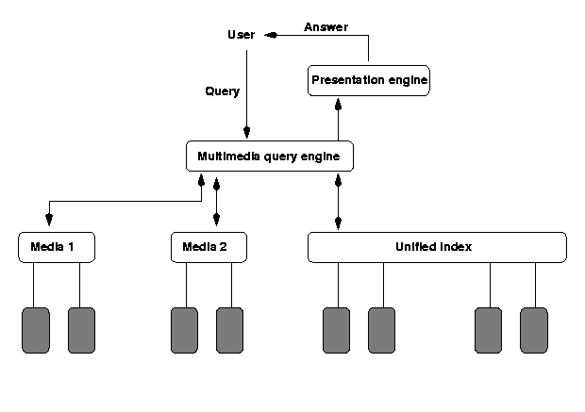
MM Database Architectures (cont.)
Based on Principle of Hybrid Organization
A hybrid of the first two. Certain media types use their own indexes, while others use the "unified" index
An attempt to capture
the advantages of the
first two
Joins across multiple
data sources using their
native indexes
MM Database

Slide 11
Organizing Multimedia Data Based on the
Principle of Uniformity
Consider the following statements about media data and they may be made by a human or may be produced by the output of an image/video/text content retrieval engine.
  The image photol.gif shows Jane Shady, “Big Spender” and an unidentified third person, in Sheung Shui. The picture was taken on January 5, 1997.
  The video-clip videol.mpg shows Jane Shady giving “Big Spender” a briefcase (in frames 50-100). The video was obtained from surveillance set up at Big Spender’s house in Kowloon Tong, in October, 1996.
  The document bigspender.txt contains background information on Big Spender, a police’s file.
MM Database

Slide 12
Metadata and Media Abstraction
All these statements are Meta-data statements.
  Associate, with each media object o_{i}, some meta-data, md(o_{i})
  If our archive contains objects o₁,..., o_{n}, then index the meta data md(o₁),..., md(o_{n}) in a way that provides efficient ways of implementing the expected accesses that users will make.
We expect to take use of a single data structure to represent metadata
This can be achieved via media abstractions
Media abstractions are mathematical structure representing such media content.
Let’s consider a simple multimedia database system (SMDS) hereafter!
MM Database

Slide 13
Querying SMDSs (Uniform Representation)
Querying SMDS based on top of SQL. Basic functions include:
FindType(Obj): This function takes a media object Obj as input, and returns the output type of the object. For example,
  FindType(iml.gif) = gif.
  FindType(moviel.mpg) = mpg.
FindObjWithFeature(f): This function takes a feature f as input and returns as output, the set of all media objects that contain that feature. For example,
FindObjWithFeature(john)= {iml.gif,im2.gif,im3.gif,videol.mpg:[1,5]}. FindObjWithFeature(mary)= {videol.mpg:[1,5],videol.mpg:[15,50]}.
MM Database

Slide 14
Querying SMDSs (Uniform Representation) (cont.)
FindObjWithFeatureandAttr(f,a,v): This function takes as input, a feature f, an attribute name a associated with that feature, and a value v. It returns as output, all objects obj that contain the feature and such the value of the attribute a in object obj is v. E.g.
  FindObjWithFeatureandAttr(Big Spender,suit,blue): This query asks to find all media objects in which Big Spender appears in a blue suit.
FindFeaturesinObj(Obj): This query asks to find all features that occur within a given media object. It returns as output, the set of all such features. For example,
  FindFeaturesinObj (iml.gif): This asks for all features within the image file iml.gif. It may return as output, the objects John, and Lisa.
  FindFeaturesinObj(videol.mpg:[1,15]): This asks for all features within the first 15 frames of the video file videol.mpg. The answer may include objects such as Mary and John.
MM Database

Slide 15
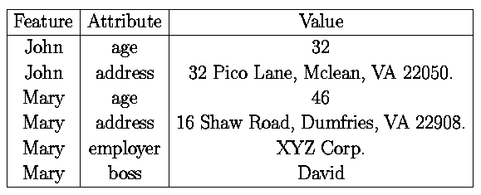
Querying SMDSs (Uniform Representation) (cont.)
FindFeaturesandAttrinObj(Obj): This query is exactly like the previous query except that it returns as output, a relation having the scheme
  (Feature,Attribute,Value)
where the triple (f,a,v) occurs in the output relation iff feature f occurs in the query FindFeaturesinObj(Obj) and feature f's attribute a is defined and has value v. For example,
  FindFeaturesandAttrinObj(iml.gif) may return as answer, the table
MM Database

Slide 16
Querying SMDS by SMDS-SQL
All ordinary SQL statements are SMDS-SQL statements. In addition:
The SELECT statement may contain media-entities. A media entity is defined as follows:
  If m is a continuous media object, and i, j are integers, then m:[i, j] is a media-entity denoting the set of all frames of media object m that lie between (and inclusive of) segments i, j.
  If m is not a continuous media object, them m is a media entity.
  If m is a media entity, and a is an attribute of m, then m.a is a media-entity.
The FROM statement may contain entries of the form
<media> <source> <M>
which says that only media-objects associate with the named media type and named data source are to be considered when processing the query, and that M is a variable ranging over such media objects.
MM Database

Slide 17
Querying SMDS by SMDS-SQL (cont)
The WHERE statement allows (in addition to standard SQL constructs), expressions of the form
term IN func_ca11
where
  term is either a variable (in which case it ranges over the output type of func_call) or an object having the same output type as func_call and
  func_call is any of the five function calls stated above
MM Database

Slide 18
Sample SMDS-SQL Statements
Find all image/video objects containing both Jane Shady and Big Spender. This can be expressed as the SMDS-SQL query:
SELECT M
FROM smds source1 M
WHERE (FindType(M)=Video OR FindType(M)=Image)
AND
M IN FindObjWithFeature(Big Spender)
AND
M IN FindObjWithFeature(Jane Shady).
MM Database

Slide 19
Sample SMDS-SQL Statements (cont.)
Find all image/video objects containing Big Spender wearing a purple suit. This can be expressed as the SMDS-SQL query:
SELECT M
FROM smds sourcel M
WHERE (FindType(M)=Video OR FindType(M)=Image)
AND
M IN FindObjWithFeatureandAttr(Big Spender, suit, purple)
MM Database

Slide 20
Sample SMDS-SQL Statements (cont.)
Find all images containing Jane Shady and a person who appears in a video with Big Spender. Unlike the preceding queries this query involves computing a "join" like operations across different data domains. In order to do this, we use existential variables such as the variable "Person" in the query below, which is used to refer to the existence of an unknown person whose identity is to be determined.
  SELECT M,Person
  FROM smds sourcel M,M1
  WHERE (FindType(M)=Image) AND
  (FindType(M1)=Video) AND
  M IN FindObjWithFeature(Jane Shady) AND
  M1 IN FindObjWithFeature(Big Spender) AND
  Person IN FindFeaturesinObj (M) AND
  Person IN FindFeaturesinObj (M1) AND
  Person≠Jane Shady AND Person≠Big Spender
MM Database

Slide 21
Querying SMDSs (Hybrid Representation)
SMDS-SQL may be used to query multimedia objects which are stored in the uniform representation.
“What is it about the hybrid representation that causes our query language to change?”
In the uniform representation, all the data sources being queried are SMDSs, while in the hybrid representation, different (non-SMDS) representations may be used.
A hybrid media representation basically consists of two parts - a set of media objects that use the uniform representation (which we have already treated in the preceding section), and a set of media-types that use their own specialized access structures and query language.
MM Database

Slide 22
Querying SMDSs (Uniform Representation) (cont.)
To extend SMDS-SQL to Hybrid-Multimedia SQL (HM-SQL for short), we need to do two things:
  First, HM-SQL, must have the ability to express queries in each of the specialized languages used by these non-SMDS sources
  Second, HM-SQL, must have the ability to express “joins” and other similar binary algebraic operations between SMDS sources and non-SMDS sources
MM Database

Slide 23
HM-SQL
HM-SQL is exactly like SQL except that the SELECT, FROM, WHERE clauses are extended as follows:
the SELECT and FROM clauses are treated in exactly the same way as in SMDS-SQL.
The WHERE statement allows (in addition to standard SQL constructs) expressions of the form
term IN MS:func_call
where
1. term is either a variable (in which case it ranges over the output type of func_call) or an object having the same output type as func_call as defined in the media source MS and
MM Database

Slide 24
HM-SQL (cont.)
2. either MS=SMDS and func_call is one of the five SMDS functions described earlier, or
3. MS is not an SMDS-media source., and func_call is a query in QL(MS).
Thus, there are 2 differences between HM-SQL and SMDS-SQL:
1. func_calls occurring in the WHERE clause must be explicitly annotated with the media-source involved, and
2. queries from the query languages of the individual (non-SMDS) media-source implementations may be embedded within an HM-SQL query. This latter feature makes HM-SQL very powerful indeed as it is, in principle, able to express queries in other, third-party, or legacy media implementations.
MM Database

Slide 25
Sample HM-SQL Statements
Find all video clips containing Big Spender, from both the video sources, videol, and video2, where the former is implemented via an SMDS and the latter is implemented via a legacy video database:
  SELECT M
  FROM smds video1, videodb video2
  WHERE M IN smds:FindObjWithFeature(Big Spender) OR
  M IN videodb:FindVideoWithObject(Big Spender)
MM Database

Slide 26
Sample HM-SQL Statements (cont.)
Find all people seen with Big Spender in either video1, video2, or idb.
  (SELECT P1
  FROM smds video1 V1
  WHERE V1 IN smds:FindObjWithFeature(Big Spender)AND
  P1 IN smds:FindFeaturesinObj(V1) AND
  Pl≠Big Spender) UNION
  (SELECT P2
  FROM videodb video2 V2
  WHERE V2 IN videodb:FindVideoWithObject(Big Spender) AND
  P2 IN videodb:FindObjectsinVideo(V2) AND
  P2≠Big Spender) UNION
  (SELECT P3
  FROM imagedb idb I3
  WHERE I3 IN imagedb:getpic(Big Spender) AND
  P3 IN imagedb:getfeatures(I3) AND
  P3≠Big Spender)
MM Database

Slide 27
Connective Summary
When faced with the problem of creating a multimedia database, we must take into account the following two questions:
What kinds of media data should this MM database provide access to?
Do legacy algorithms already exist (and are they available) to index this data reliably and accurately using content-based indexing methods?
⇒ determine the use of uniform representation or hybrid representation !!
In the text, the author has also shown how to index SMDSs with enhanced inverted indices (an easy-to-implement mechanism for indexing large document bases).
MM Database

